Slide 1
Comparative Evaluation of Pretrained Diffusion Models for Text-and-Image Guided Generation
Beeram Sandya CS21BTECH11006
Challa Akshay Santoshi CS21BTECH11012
Cheekatla Hema Sri CS21BTECH11013
Cherukupalli Sai Malini Mouktika AI21BTECH11007

Slide 2
Introduction
Conditional image generation is a task where the output image is generated based on both an input image and a textual prompt.
This technique enables controllable and guided image synthesis, crucial for applications like image editing, style transfer, and content-aware image manipulation.
Our project explores and compares four state-of-the-art approaches in this domain, spanning different architectural paradigms:
Structure-aware models
Instruction-tuned models
Adapter-based models
Latent consistency-based models

Slide 3
Motivation
The rapid development of vision-language models has opened new possibilities for fine-grained control in image generation tasks.
Existing models use different mechanisms (e.g., attention, adapters, or learned conditions) to align images with prompts, but their comparative strengths remain under-explored.
Understanding their performance differences helps answer key questions:
Which model better preserves image structure?
Which responds more faithfully to the prompt?
Which generalizes across diverse inputs?
By benchmarking these models, we aim to provide insights that can guide model selection for real-world applications like creative design, virtual try-on, or content customization.

Slide 4
Problem Statement
Numerous models have been proposed for conditional image generation, each using different mechanisms to interpret and apply textual prompts to modify input images.
However, there is limited comparative analysis to understand how these models perform under consistent settings with diverse prompt-image pairs.
This project focuses on evaluating and comparing four representative models from different architectural families:
Stable Diffusion
ControlNet (structure-aware)
InstructPix2Pix (instruction-tuned)
T2I-Adapter (adapter-based)
U-Net with Latent Consistency Model (LCM) (latent diffusion-based)

Slide 5
Problem Statement (continued)
The core problem is to assess how effectively each model:
Preserves critical features of the input image
Accurately reflects the semantic intent of the prompt
Maintains visual quality and coherence
Our goal is to identify the strengths and trade-offs of each approach to in guided image synthesis.

Slide 6
Literature Review
Stable Diffusion Model
ControlNet
T2I-Adapter
InstructPix2Pix
LCM
ControlNet++
DiffEdit

Slide 7
Dataset
It is JSON file with each object has an image url and a prompt
An example:
{ "image_url":"https://images.pexels.com/photos/1076758/pexels-photo-1076758.jpeg",
"prompt": "Change this jelly fish into a dolphin"
}
The prompts are designed to test:
Style: Artistic transformations
Content: Adding/removing elements
Context: Environmental changes
Complexity: Multi-faceted instructions

Slide 8
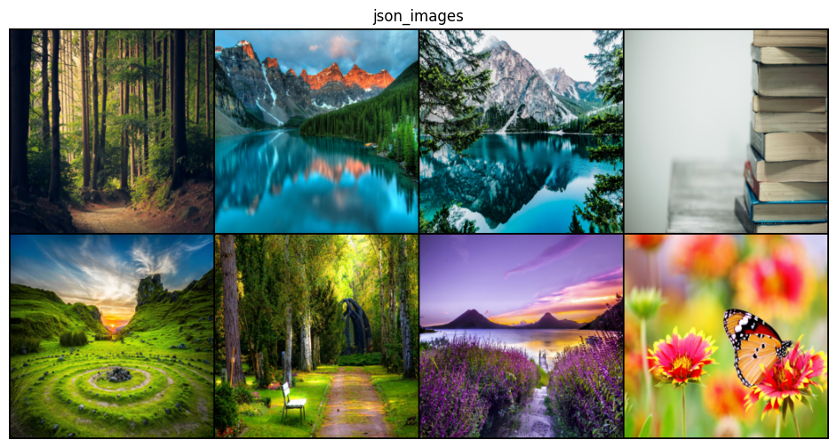
Sample Input
Add a group of students going home on the road in this image
Add a colossal ancient ruin with glowing symbols in this mountain landscape.
make this view like a snowy winter morning
Transform this stack of books into a magical library scene, where the books glow softly and one is floating open in the air
Add a hot air balloon festival with dozens of colorful balloons in this sky.
Turn the trees to bamboo trees
add a decorated stage for a wedding ceremony in the appropriate place
Transform all the flowers into butterflies

Slide 9
Stable Diffusion
A latent diffusion model for generating images from text or images.
Operates in compressed latent space for efficiency.
Developed by Stability AI, open-source and widely adopted.
Img2img :
Takes an input image and a text prompt. Outputs a new image that blends the original with prompt guidance. Parameters:
Strength: How much to modify the input.
Guidance Scale: How closely to follow the prompt.

Slide 10
Stable Diffusion
Model Architecture:
Backend: Stable Diffusion
Components:
Autoencoder (VAE) – encodes/decodes images.
UNet – denoises latent representation.
CLIP – encodes text prompts.

Slide 11
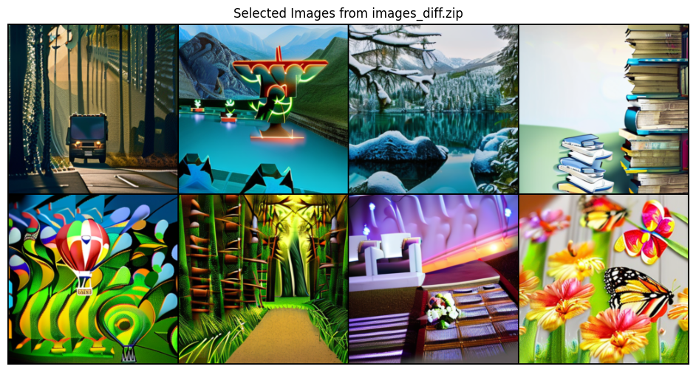
Stable Diffusion
Followed Spatial Conditioning to some extent
Less Realistic

Slide 12
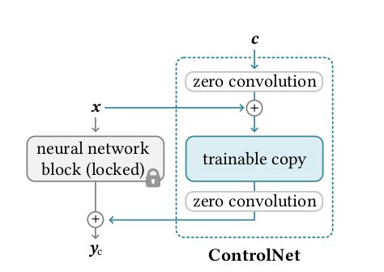
ControlNet
ControlNet enhances Stable Diffusion by enabling image generation conditioned on additional inputs like edges, poses, or depth maps.
It works by adding a parallel, trainable copy of the UNet that processes the conditioning image.
Outputs from this branch are merged into the main UNet using zero convolutions, which start as inactive and gradually learn to influence generation.
This design allows precise control over the generated image without disrupting the pretrained Stable Diffusion weights.
Result: the model can follow both text prompts and structural cues in image generation

Slide 13
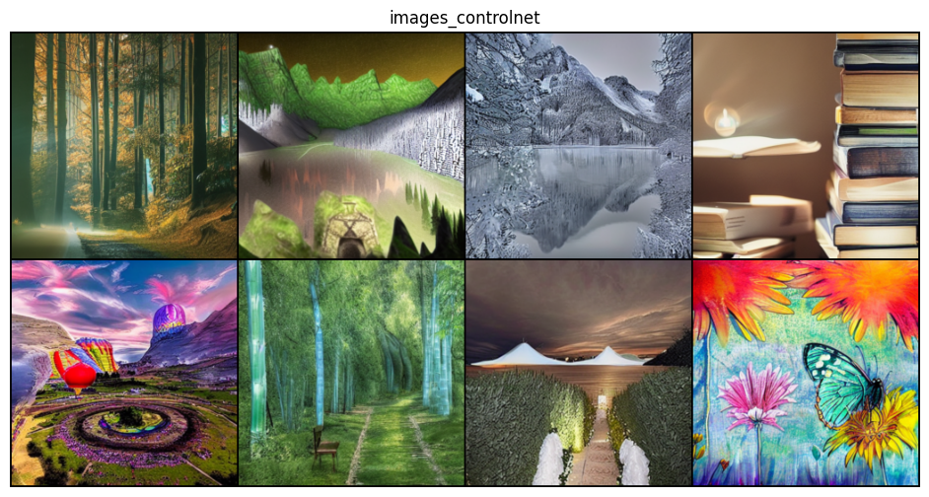
ControlNet Outputs
Preserves the input image structure
Focuses more on input structure than the prompt
Worked for some extent to the complex prompt

Slide 14
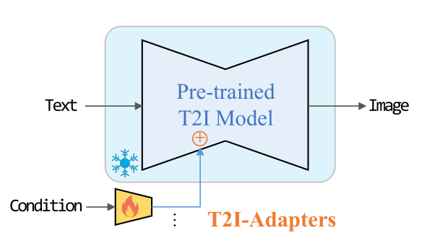
T2I-Adapter
Lightweight adapter modules for controlling pretrained text-to-image diffusion models
Architecture:
Base (Stable Diffusion) + CNN-based adapter
Adapter: Visual Input → Features →Fused into UNet Decoder layer
Training:
Only adapters are trained
Loss: Standard Denoising loss (DDPM)
Benefits:
Lightweight training
Modular (Plug and play)

Slide 15
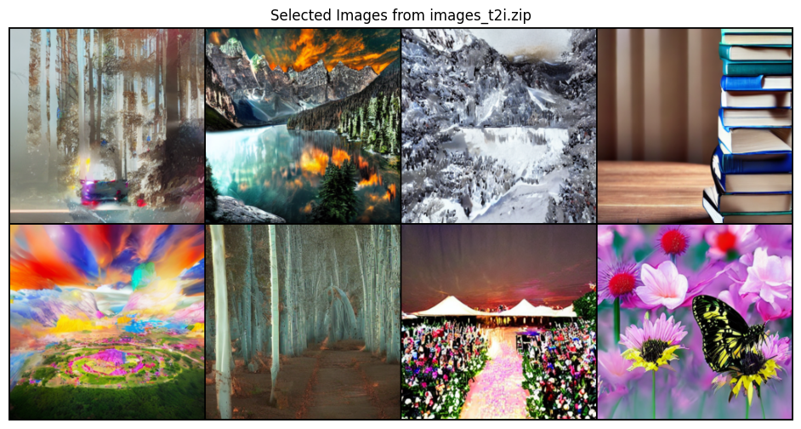
Outputs of T2I Adapter
Followed the spatial structure strongly
Failing to add new objects
Realistic images
Failed for complex prompts

Slide 16
InstructPix2Pix
Instruction-based conditioning: User provides free-form edit instructions, not just prompts
Architecture:
Base: Stable Diffusion (VAE + UNET + CLIP encoder)
Modified U-Net accepts three inputs:
Noisy Latent
Image Embedding
Instruction Embedding
Training:
Only UNet is Trained
DDPM loss

Slide 17
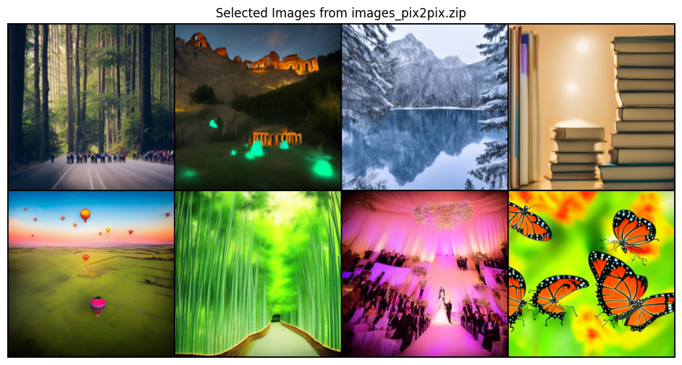
InstructPix2Pix Outputs
Followed Spatial conditioning well
Able to follow exact directions in the prompts
High Quality
Realistic

Slide 18
LCM
Latent Consistency Models are a faster alternative to traditional diffusion models.
They generate high-quality images in just 2–8 steps, compared to 25–50 steps in Stable Diffusion.
Architecture:
Base Model: Stable Diffusion
LCM Component: Replaces the standard UNet with a latent consistency–distilled UNet, trained to generate images in fewer steps
Benefits:
Ultra-fast Inference
Consistency Distillation
Plug and Play

Slide 19
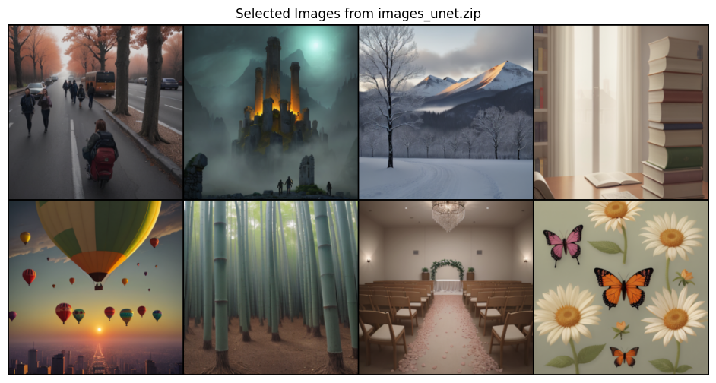
LCM Outputs
Followed prompts strongly
Ignored spatial info from base images
High quality
More Realistic

Slide 20
Evaluation
Inception Score:
evaluates both the quality and diversity of generated images by analyzing the confidence and entropy of class predictions from a pretrained Inception v3 network.
FID:
FID compares the statistical distributions (mean and covariance) of real and generated image embeddings extracted from the Inception v3 network.
CLIP Score:
measures the semantic alignment between the generated image and the corresponding textual prompt

Slide 21
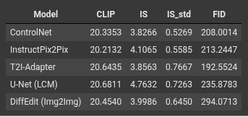
Metrics Results
LCM and T2I-Adapter show stronger alignment between prompt and image semantics.
T2I-Adapter offers naturalistic images(FID)
Diffusion Model Shown more synthetic looking images
InstructPix2Pix shown solid performance across all matrics
ControlNet shown moderate performance (Highly aligned to spatial conditioning)

Slide 22
Insights
Criterion | Best Model | Notes
Prompt Alignment | U-Net | CLIP ~20.68, 20.64
Image Quality | U-Net | IS = 4.7632
Output Consistency | ControlNet | Lowest IS_std
Realism (FID) | T2I-Adapter | Closest to real images
Worst FID (Least Realistic) | Stable Diffusion | FID = 294.07
Prompt + Consistency Balance | InstructPix2Pix | Good overall metrics

Slide 23
Learnings
Which model better preserves image structure?
ControlNet
Which responds more faithfully to the prompt?
UNet with LCM
Which generalizes across diverse inputs?
InstructPix2Pix
InstructPix2Pix is best if u want a balance of input image(conditional) structure and prompt
ControlNet is best if u want to preserve the input image structure to a greater extent
T2I-Adapter follows the prompt better than the ControlNet
UNet with LCM follows the prompt strongly but does not care much about the conditional image.

Slide 24
Learnings
Application of learned concepts: latent space, DDPM, UNet, Diffusion Models
Gained hands-on experience with popular pretrained models: ControlNet, T2I-Adapter, InstructPix2Pix, DiffEdit, and LCM
Learned to evaluate generative models using FID, Inception Score, and CLIP similarity
Improved ability to read and interpret research papers to understand underlying techniques

Slide 25
References
https://huggingface.co/docs/diffusers/en/using-diffusers/controlnet
ControlNet
https://huggingface.co/docs/diffusers/en/using-diffusers/t2i_adapter
T2I-adapter
https://huggingface.co/docs/diffusers/en/training/instructpix2pix
InstructPix2Pix
https://huggingface.co/docs/diffusers/using-diffusers/inference_with_lcm
UNet with LCM
https://huggingface.co/docs/diffusers/en/api/pipelines/diffedit

Slide 26
Individual Contributions
Sandya
Literature Review
ControlNet Implementation
Report Writing
Making Presentation Slides
Dataset Preparation
Sai Malini Mouktika
Literature Review
Diffusion Model Implementation
Report writing
Making Presentation Slides
Akshay Santoshi
Literature Review
Report Writing
Evaluation Metrics Implementation
Hema Sri
Literature Review
Report Writing
T2I-Adapter, LCM, InstructPix2Pix Implementation
Making Presentation Slides
Dataset Preparation

